Slide 1
House Price Prediction
By-
Ananya Devaraju
Jagapthi Raju
Ossai, Oge
Priyanka Bhagwat
Rathan Narayana Raju
Sagar Gondaliya

Slide 2
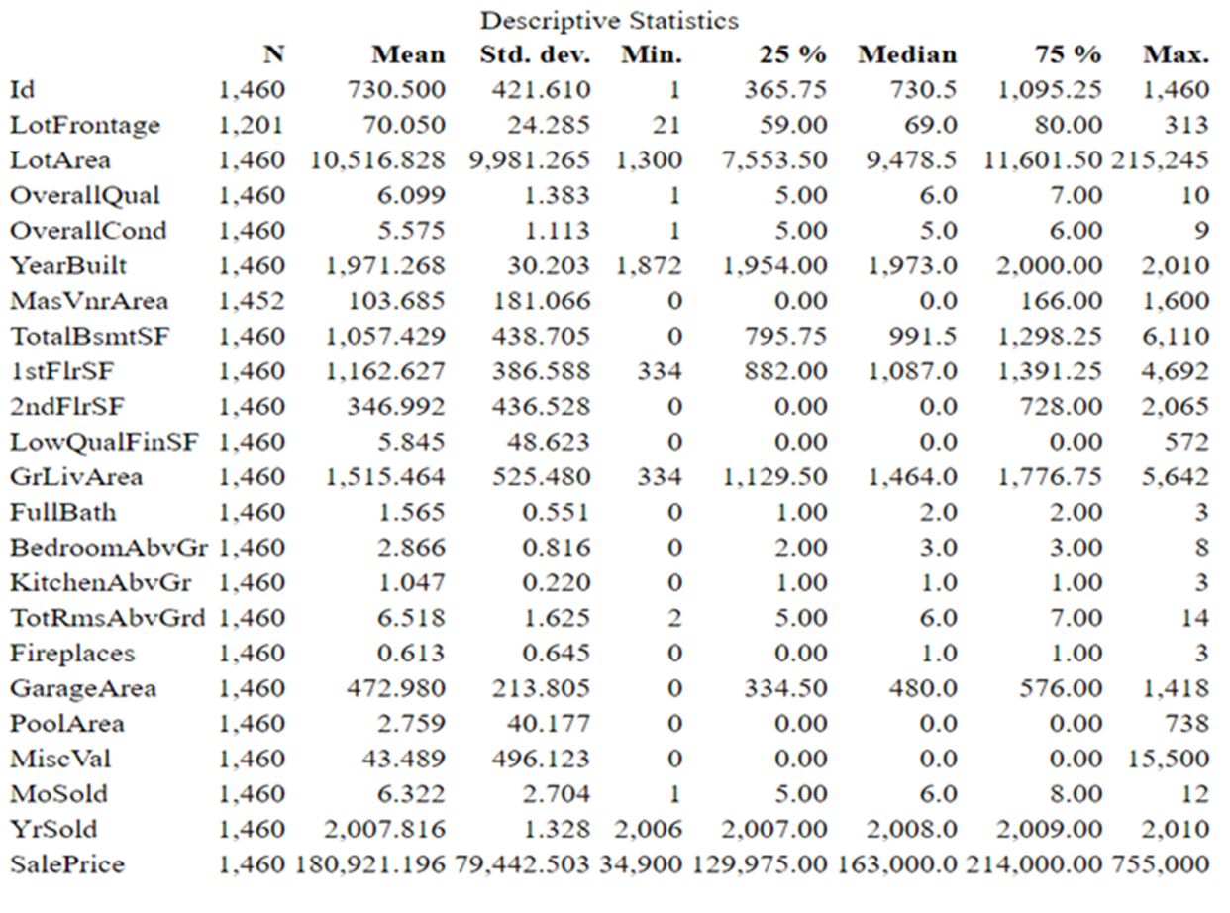
Numerical and Graphical Representation of House Price Data
DESCRIPTIVE STATISTICS:
The house data consists of 1460 rows and 51 columns.
In this the data, the sales price is the predictor variable and remaining are response variables.
Almost all these variables in statistics describe the properties of the house.
The mean of variables YrBuilt is 1972 and YrSold is 2007. there is almost 15 years difference.
The median and mean of these two variables has only 1 year difference.
The medians of the variables 2ndflrsf, LowqualFinsf, Miscval and Mosold is zero which is strange.

Slide 3
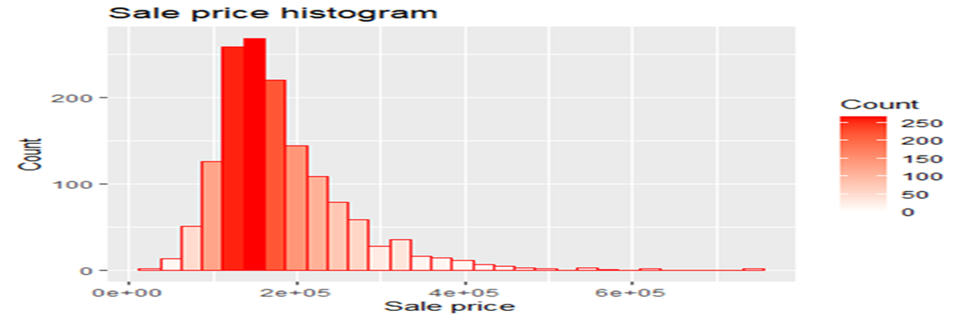
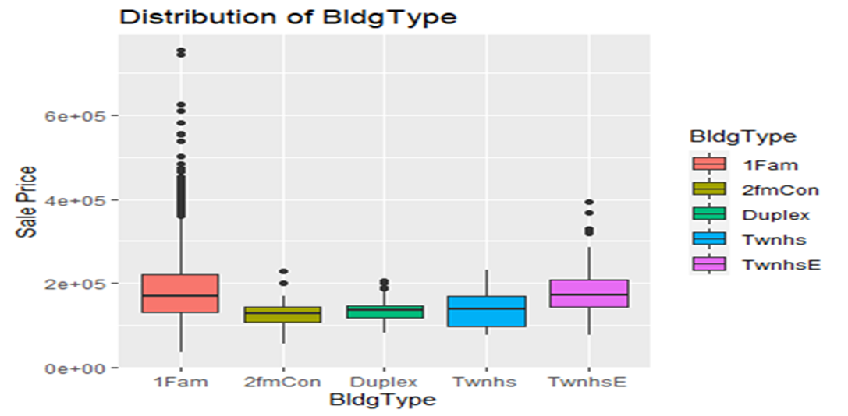
GRAPHICAL REPRESENTATION:
The sales Price is high at 1,63,000 and after that it decreases very rapidly and stops at 7,55,000.
the boxplots of each variable is drawn against the sales price to observe, how each variable affects the sales price of the house.
The sales price of the 1story and 2story house style are high when compared to the other styles.
There are no outliers in 1.5Unf housestyle and it has low sales price. There are more outliers present in only one attribute.
outliers are observed after plottinf all the variables against salesprice.

Slide 4
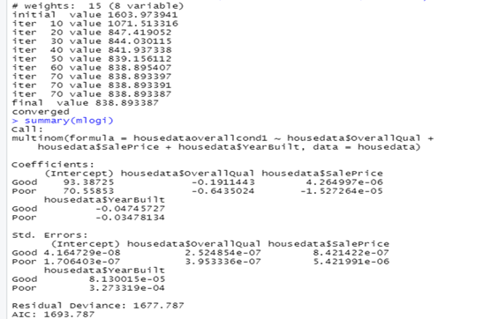
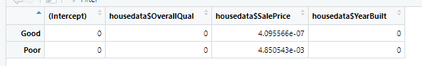
Multinomial Logistic Regression
In order to find logistic regression the program ISLR and nnet.
The multinomial logistic regression is utilised to predict the possiblity of an outcome.
The multinominal logistic regression was used when working out the overall condition of the houses.
The overall condition is mostly average and so the average was used as the reference.

Slide 5
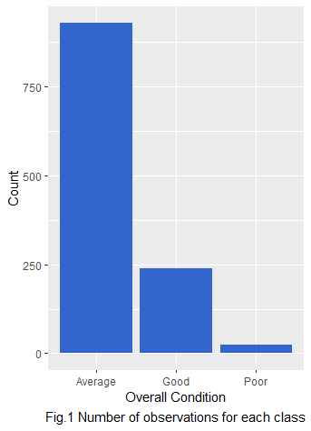
Classifying house condition using Decision Tree
Data Cleaning:
Replace missing values
Check class of predictor variables
Imbalanced data
Fitting Model:
Train-test split
Fit Decision tree on train
Predict on test

Slide 6
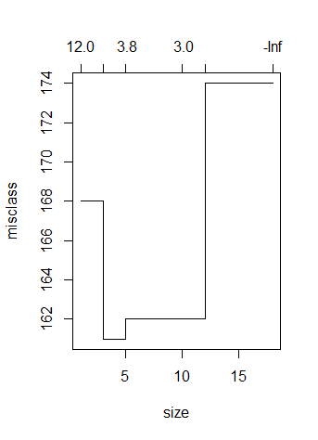
Classifying house condition using Decision Tree (Continued)
Confusion matrix
Tree pruning
Using CV to get best alpha (subtrees)
Accuracy on test data : 82.9%
Other metrics:
Sensitivity
Specificity
Balanced accuracy
 | Average | Good | Poor
Average | 261 | 47 | 4
Good | 7 | 34 | 0
Poor | 2 | 1 | 2
Statistics by class
 | Average | Good | Poor
Sensitivity | 96.67 | 41.46 | 33.33
Specificity | 42 | 97.46 | 99.15
Balanced Accuracy | 69.36 | 69.46 | 66.24

Slide 7
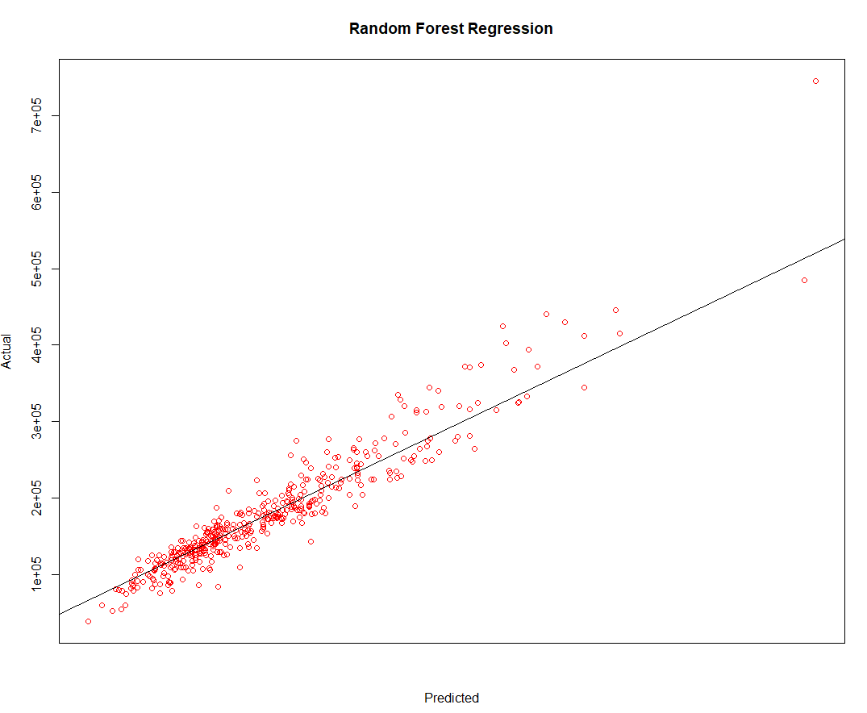
House Price Predictor using Regression
Random Forest Regression
Random Forest Regression is a supervised learning algorithm for regression that employs the ensemble learning process.
R squared score tells us how well our model is fitted. In this case, it is around 90 percent

Slide 8
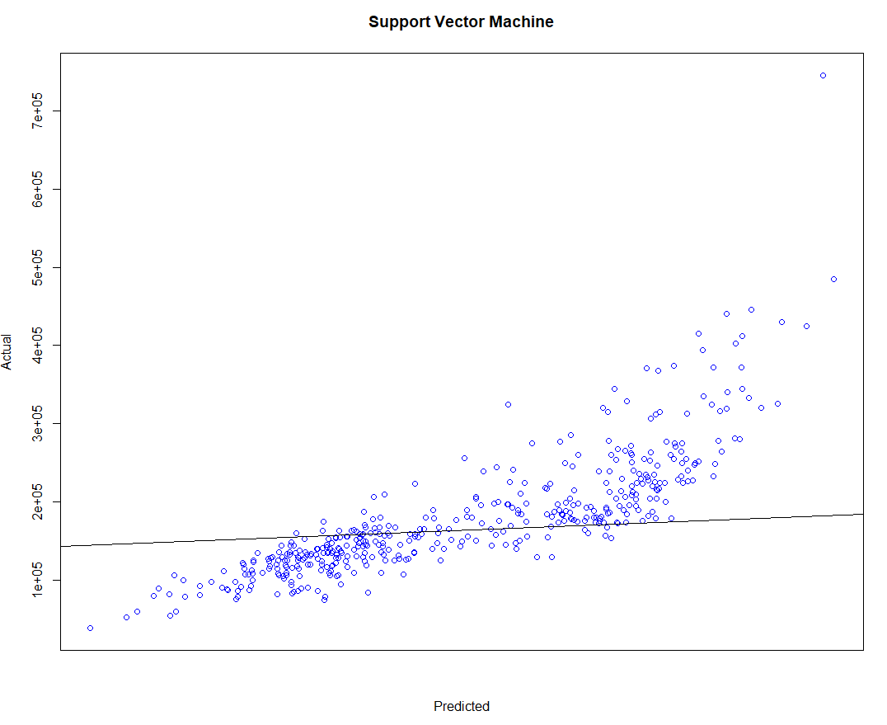
House Price Predictor using Regression
Support Vector Machines
Support Vector Machine is to create multiple separating hyperplanes, dividing the data into segments with only one type of data in each segment.
In this case, the R Squared is around 66 percent which is not a great fit.

Slide 9
Resampling methods
K-fold Cross Validation
𝐾-Fold Cross-Validation is a popular choice, usually 𝐾 selected as 5 or 10 according to empirical experience.
Cross validation resamples without replacement.
10-fold cross-validation estimator of root mean squared error
Root mean squared error: 32407.43
Bootstrapping
For evaluating the performance of statistical learning methods, bootstrap has comparable performance as 𝐾-fold cross validation.
Bootstrap resamples with replacement
Bootstrap estimator of root mean squared error with 25 bootstrap replications
Root mean squared error: 31378.4
Notes:
Cross validation approaches are general approach for estimating true performance of statically learning methods . Bootstrap is a useful method to quantify the uncertainty associated with a given estimator or statistical learning method . After using both the methods on random forest, we get the less RMSE for bootstrap method. So less the RMSE, fit the model.

Slide 10
Methodology
Collect data
Preprocessing data
Determine variable
Calculate variable using PSO
Get prediction
Prediction using
mean absolute percentage error (MAPE) & root mean squared error (RMSE).
Calculate variable using
Regression analysis

Slide 11
Conclusion
Therefore, we can conclude that Random forest regression model performed much better than SVM because random forests are made up of decision trees, each of which draws a sample of random data, they are extremely accurate.
As a result, random forests have a higher R squared forecast.
After using resampling methods of Bootstrapping and cross validation, we can say bootstrap gives better fit to the model.

